Slide 1


Introduction to
Robotic Process Automation
Automated Deadline Notification Bot
220701137
KRITHIKA B
Mrs. SASIKALA GM
Assistant Professor
Department of Computer Science and Engineering

Slide 2
Abstract
- The Automated Deadline Notification Bot is an RPA solution developed using UiPath to manage project deadlines.
- The bot automates the monitoring of task deadlines and sends email notifications to the concern person.
- It processes an Excel file containing task names, deadlines, and assigned personnel to identify tasks with approaching deadlines.
- Personalized email alerts are generated for each task to ensure timely action.
- The bot uses dynamic date calculations and supports scheduled execution for continuous monitoring.
- It reduces manual tracking efforts, enhances productivity, and improves project management efficiency through automation.

Slide 3
Need for the Proposed System
- Ensures timely reminders for approaching deadlines, reducing the risk of missed tasks.
- Automates the process of tracking deadlines, eliminating manual effort and human error.
- Improves team productivity by enabling stakeholders to focus on task execution rather than deadline monitoring.
- Provides a scalable solution that supports multiple projects and dynamic deadline management.
- Enhances communication and coordination through personalized email notifications for stakeholders.

Slide 4
Advantages of the Proposed System
- Automates deadline tracking and notification processes, saving time and effort.
- Reduces the risk of missed deadlines by providing timely reminders.
- Improves accuracy by eliminating human errors in manual tracking.
- Enhances team collaboration with personalized and targeted notifications.
- Supports scalability for managing multiple projects and tasks efficiently.

Slide 5
Literature Survey
Paper 1
Advantages
- Provides a comprehensive overview of Robotic Process Automation (RPA) applications in deadline management.
- Demonstrates a significant reduction in manual workload by automating notification processes.
- Highlights improved task organization and deadline adherence in collaborative environments.
Disadvantages
- Focuses primarily on general RPA applications without detailing implementation challenges for specific use cases.
- Limited discussion on data privacy and security concerns related to handling sensitive project data.

Slide 6
Paper 2
Advantages
- Explores the integration of email systems with automation tools for seamless communication.
- Emphasizes dynamic adaptability to changing deadlines and task statuses.
- Suggests methods to improve efficiency through periodic task monitoring and scheduled automation.
Disadvantages
- Requires advanced configuration and knowledge of automation tools, which may not be accessible to all users.
- Lacks insights into potential issues with email delivery or system compatibility during implementation.

Slide 7
Main Objective
- Automate the tracking of task deadlines within projects.
- Send timely email notifications to relevant stakeholders.
- Reduce manual effort and time spent on deadline management.
- Enhance team productivity by ensuring tasks are completed on time.
- Foster a proactive approach to task execution and prevent delays.

Slide 8
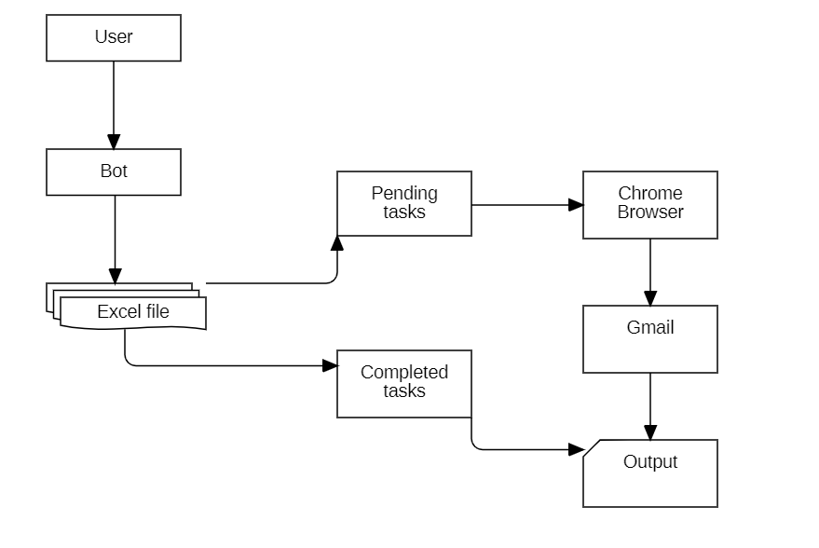
Architecture

Slide 9
System Requirements
Hardware Requirements:
A computer or server with internet access to run UiPath Studio and execute automation processes.
Sufficient RAM (8GB or higher) and storage (at least 50GB free space) to handle the execution of tasks and processing of Excel files.
Software Requirements:
UiPath Studio installed to design and deploy the RPA workflows.
Microsoft Excel (2016 or later) for managing task data and storing the results of deadline notifications.

Slide 10
Functional Description
Module 1: Task Data Management
This module is responsible for managing and processing the data related to tasks. It reads task details from an Excel file, including task names, deadlines, assigned personnel, and email addresses. It organizes and analyzes the data to identify tasks with upcoming deadlines.
Module 2: Notification System
This module handles the generation and sending of email notifications to stakeholders about impending task deadlines. It dynamically calculates deadlines, creates personalized email messages, and sends them to the relevant personnel based on the task's details.

Slide 11
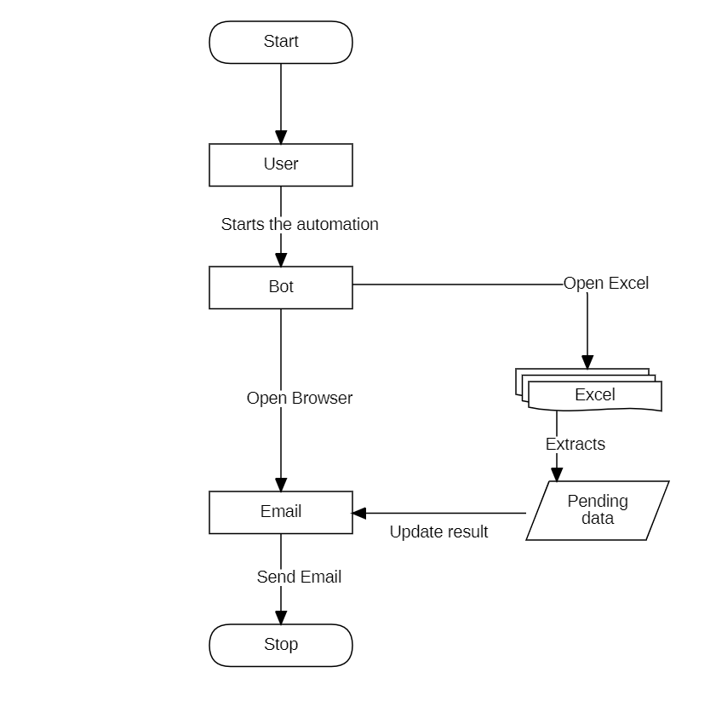
System Flow diagram

Slide 12
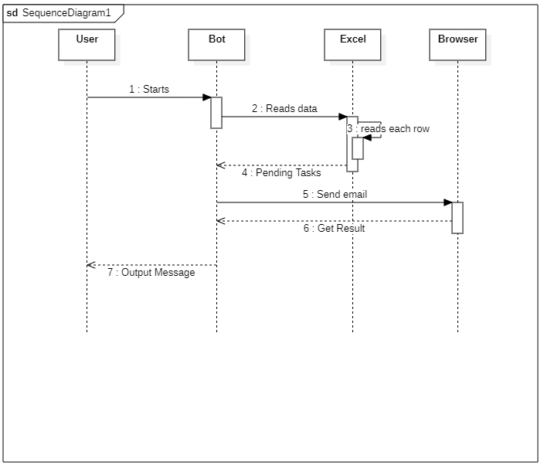
Sequence Diagram

Slide 13
Process Design
Main Process
Automates the workflow of reading task deadlines from an Excel file.
Dynamically identifies tasks with approaching deadlines and notifies stakeholders via email
Sub Process
Extracts task data from the Excel sheet and filters tasks based on proximity to deadlines.
Formats email content to ensure customized notifications.
Sends notifications only to relevant recipients for actionable insights.

Slide 14
Implementation
Module 1
-Start Confirmation Message: Displays an initial message to confirm that the bot has started its process.
-Excel Read Activity: Reads the task data from an Excel file using the Read Range activity.
-For Each Row Activity: Iterates through each row in the Excel data table to extract relevant task details.
-Condition Check: Implements logical conditions to filter tasks with deadlines approaching within a set timeframe.
Module 2
-Open Browser: Launches the email client or service for performing actions.
-Type Into Activity: Inputs email content or recipient addresses dynamically based on extracted data.
-Click Activity: Automates clicks for navigating the interface, such as the send button.
-SMTP Email Sending: Configures and sends emails using the Send SMTP Mail Message activity for automated notifications.
-Success Confirmation Message: Displays a final confirmation that notifications have been sent successfully.

Slide 15
Conclusions
1. The Automated Deadline Notification Bot effectively streamlines task management by automating the process of tracking deadlines and sending timely reminders, ensuring improved project efficiency.
2. By leveraging UiPath's RPA capabilities, the system minimizes manual intervention, reduces errors, and enhances productivity in managing project deadlines.
3. The dynamic and personalized email notification feature ensures that stakeholders receive actionable insights, fostering better collaboration and accountability.
4. This innovative solution demonstrates the potential of automation in optimizing routine workflows, making it a valuable tool for deadline-driven environments.

Slide 16
Future Enhancement
Integration with Calendar Systems: The system can be enhanced to sync with popular calendar applications like Google Calendar or Microsoft Outlook, enabling stakeholders to receive reminders directly on their calendar events.
AI-Powered Deadline Prediction: By incorporating AI and machine learning models, the bot could predict potential delays based on historical data, task complexity, or individual performance trends, providing proactive notifications.
Multilingual Support: Adding multilingual capabilities to the notification system would allow the bot to send reminders in different languages, making it adaptable to a global team environment.
Mobile App Integration: Expanding the system to support mobile app notifications would provide stakeholders with real-time reminders on the go, improving responsiveness.

Slide 17
References
1. UiPath Documentation: https://docs.uipath.com
2. Microsoft Excel Integration in UiPath: https://docs.uipath.com/activities/docs/excel
3. SMTP Email Automation: https://docs.uipath.com/activities/docs/send-smtp-mail-message
4. MySQL Database Integration with UiPath: https://docs.uipath.com/activities/docs/database
5. Email Notification Systems: https://developers.google.com/gmail/api
6. UiPath Forum: https://forum.uipath.com

Slide 18
Queries

Slide 19
Demonstration

Slide 20
Thank You

